Slide 1
NETWORK SECURITY
SIMPLIFIED DES with example

Slide 2
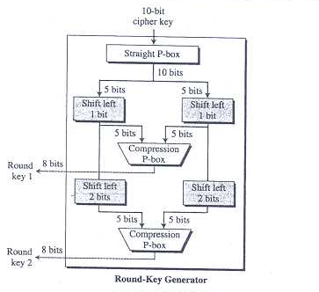
Key Generator

Slide 3

KEY GENERATION K1 and K2
Assume input 10-bit key, K, is: 1010000010
Then the steps for generating the two 8-bit round keys, K1 and K2, are:
1. Rearrange K using P10: 1000001100
2. Left shift by 1 position both the left and right halves: 00001 11000
3. Rearrange the halves with P8 to produce K1: 10100100
4. Left shift by 2 positions the left and right halves: 00100 00011
5. Rearrange the halves with P8 to produce K2: 01000011
K1 and K2 are used as inputs in the encryption and decryption stages.

Slide 4
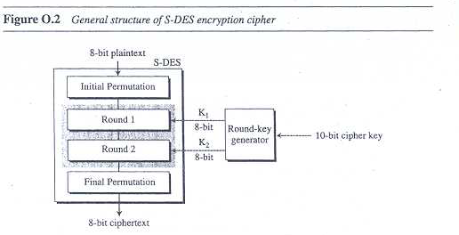

Slide 5
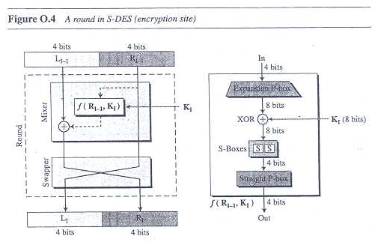

Slide 6
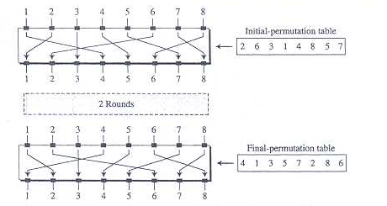
Assume a 8-bit plaintext, P: 01110010
Then the steps for encryption are:
1. Apply the initial permutation, IP, on P: 10101001

Slide 7
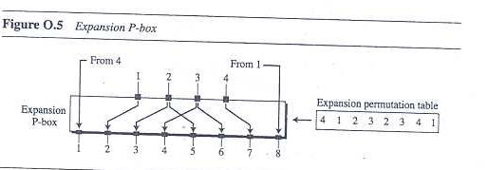
2. Assume the input from step 1 is in two halves, L and R: L=1010, R=1001
3. Expand and permutate R using E/P: 11000011
4. XOR input from step 3 with K1: 10100100 XOR 11000011 = 01100111

Slide 8
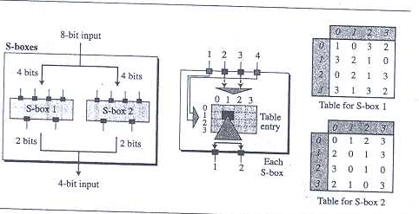
0110 0111
5. Input left halve of step 4 into S-Box S1 and right halve into S-Box S2:
a. For S1: 0110 as input: b1,b4 for row, b2,b3 for column
b. Row 00, column 11 -> output is 10
c. For S2: 0111 as input:
d. Row 01, column 11 -> output is 11

Slide 9
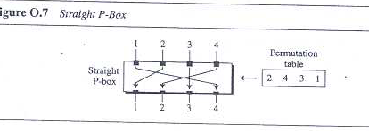
6. Rearrange outputs from step 5 (1011) using P4: 0111
7. XOR output from step 6 with L(eft) from step 2: 0111 XOR 1010 = 1101
8. Now we have the output of step 7 as the left half and the original R as the right half.
Switch the halves and move to round 2: 1001 1101

Slide 10
9. E/P with right half: E/P(1101) = 11101011
10. XOR output of step 9 with K2: 11101011 XOR 01000011 = 10101000
11. Input to s-boxes:
a. For S1, 1010
b. Row 10, column 01 -> output is 10
c. For S2, 1000
d. Row 10, column 00 -> output is 11
12. Rearrange output from step 11 (1011) using P4: 0111
13. XOR output of step 12 with left halve from step 8: 0111 XOR 1001 = 1110

Slide 11

14. Input output from step 13 and right halve from step 8 into inverse IP
a. Input us 1110 1101
b. Output is: 01110111
So our encrypted result of plaintext 01110010 with key 1010000010 is: 01110111

Slide 12
Home work
Ciphertext: 11101011
Key: 1011100110
Find Plaintext?

